Slide 1

TAKE HOME TEST
FRAUD
MODEL
Gabriel Roger do Nascimento
Data Scientist SumUp

Slide 2


GOAL
Develop a fraud detection model to identify suspicious transactions and protect our customers.

Slide 3

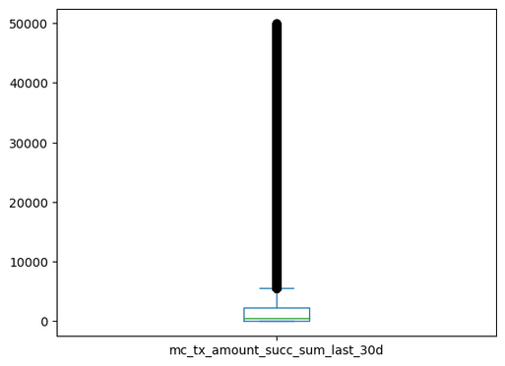
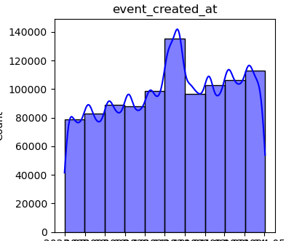
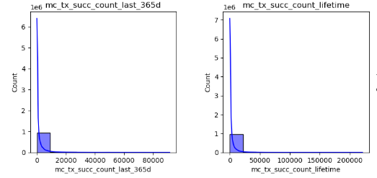
DATA
Period: 01/07/2023 to 01/05/2024
991.965 transactions after cleaned
808.513 Person's transactions
171.797 Mei's transactions
386 Legal entity's transactions
11269 Without Definition

Slide 4


PROBLEMS
DUPLICATED & NULL DATA
UNBALANCED
99%
0.005%
Not Fraud
Fraud
HIGH FEATURE DIMENSIONALITY
986956
5009

Slide 5
CLEANING & SELECTION
CLEAN DUPLICATES &
NULL DATA
BALANCING A DATASET
FEATURE SELECTION
Random Forest to determine the importance of each feature.
SelectFromModel with mean threshold to select features based on their Random Forest importance scores. This allows for an assessment of feature importance relative to one another.
Drop Duplicates: Remove any duplicate rows from the dataset.
Fill with -1: Replace missing values (NaN, None, etc.) in the remaining features with the value -1.
Smote: Oversampling minority class with synthetic data (Just Train Dataset).

Slide 6
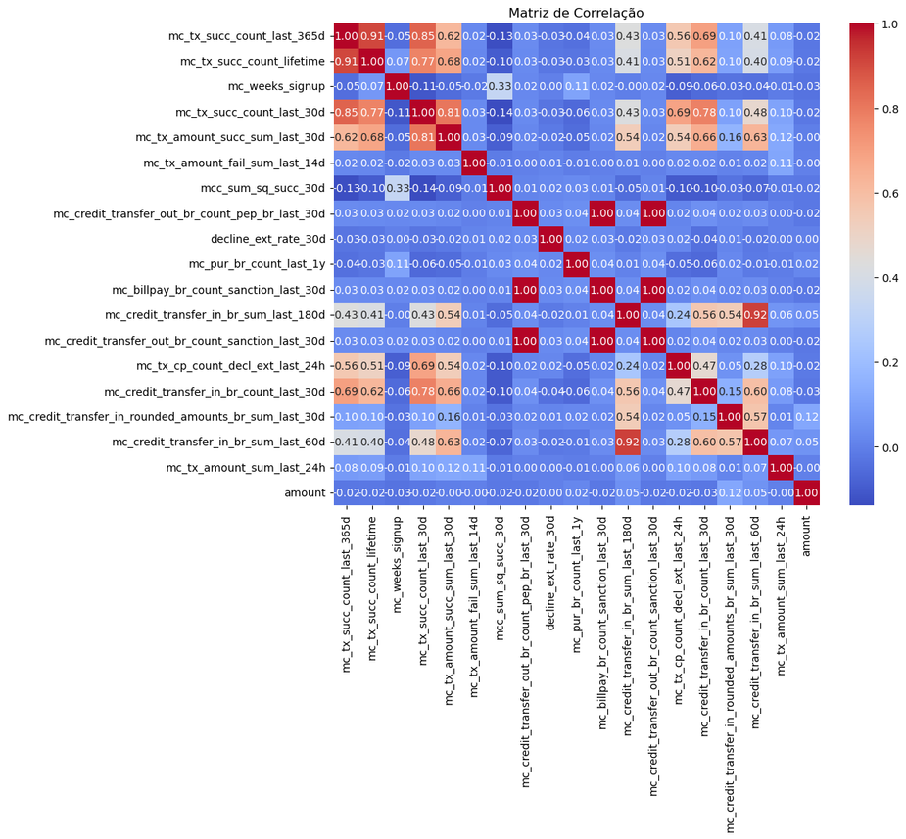
SELECTED FEATURES
mc_tx_succ_count_last_365d - 11.33%
mc_tx_succ_count_lifetime - 10.68%
mc_weeks_signup - 6.10%
mc_tx_succ_count_last_30d - 2.35%
mc_tx_amount_succ_sum_last_30d - 0.54%
mc_tx_amount_fail_sum_last_14d - 0.53%
mcc_sum_sq_succ_30d - 0.50%
mc_credit_transfer_out_br_count_pep_br_last_30d - 0.41%
decline_ext_rate_30d - 0.39%
mc_pur_br_count_last_1y - 0.33%
mc_billpay_br_count_sanction_last_30d - 0.33
mc_credit_transfer_in_br_sum_last_180d - 0.29%
mc_credit_transfer_out_br_count_sanction_last_30d - 0.23%
mc_tx_cp_count_decl_ext_last_24h - 0.22%
mc_credit_transfer_in_br_count_last_30d - 0.19%
mc_credit_transfer_in_rounded_amounts_br_sum_l.. - 0.16%
mc_credit_transfer_in_br_sum_last_60d - 0.09%
mc_tx_amount_sum_last_24h - 0.07%

Slide 7
MODEL
Data Splitting: Divide the dataset into training (70%), validation (15%), and test (15%) sets.
Data Normalization: Apply StandardScaler to normalize the features.
Grid Search: to compare the performance of Random Forest and XGBoost (with tuned hyperparameters).
Evaluate models using the ROC AUC metric.
Select XGBoost as the final model based on the best ROC AUC score.

Slide 8

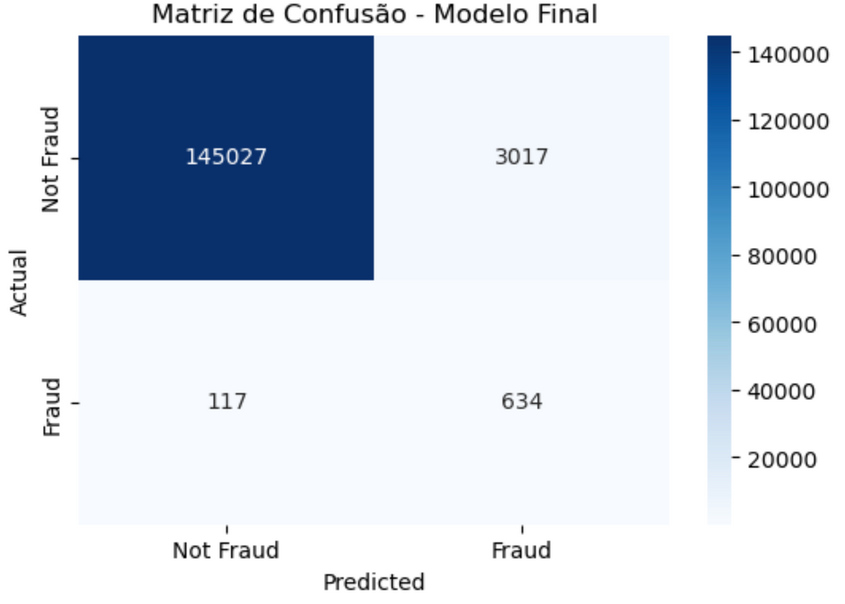
METRICS
Metrics with Threshold of 0.7:
AUC Train: 0.9924325269652872
AUC Val: 0.9645852112619379
AUC Test: 0.9697022227997787
Precision: 0.1736510545056149
Recall: 0.844207723035952
F1-Score: 0.2880508859609269

Slide 9
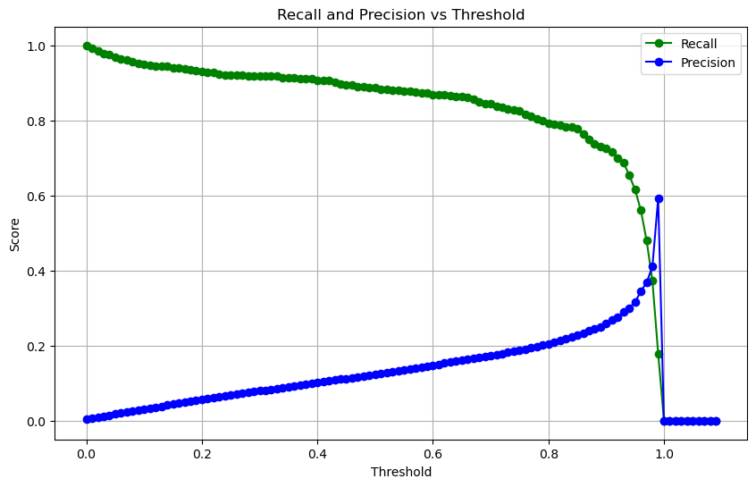
METRICS

Slide 10
CONCLUSION
Recall Prioritization: In banking, it's more critical to detect all potential fraud cases (even if it means more false positives) than to miss actual fraud cases.
False Positive Impact: False positives (classifying a legitimate transaction as fraudulent) inconvenience customers (e.g., blocked cards, extra verification
.Customers prefer to prevent fraud, even if it means occasional inconveniences from false positives.
False Negative Impact: False negatives (missing actual fraud) result in financial loss and damage to customer trust.)

Slide 11
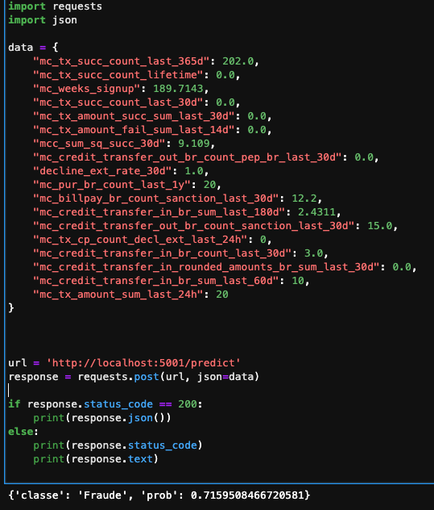
API FLASK EXAMPLE:

Slide 12
NEXT STEPS
Adjustments to the threshold or model parameters may be necessary to refine the results.
Benchmark more algorithms with different hyperparameters.
Explore more possible features and better ways to balance and select the features.
If possible, collect more data.
Improve EDA analysis.
Data related to the devices used for transactions could be a valuable area for future exploration. (Device Fingerprint)
Explore seasonality on date transactions
Time series model based

Slide 13

THANKS

